Slide 1
STRUCTURED ENERGY PRODUCTS
Market Overview & Derivatives
EUAs, PPAs, VPPs, VPSs & Weather Derivatives
A executive guide to carbon compliance markets, long-term power contracting, flexible asset virtualization, and environmental risk hedging.
TARGET AUDIENCE
FOCUS AREAS
Energy Traders, Corporates & Utility Risk Managers
Emissions, Offtake Contracts, Asset Flexibility & Weather Risk

Slide 2





MARKET TAXONOMY
Five Pillars of Modern Energy Risk Management
EUAs
PPAs / VPPAs
VPPs
VPSs
Weather
Carbon compliance allowances in the EU ETS cap-and-trade market.
Long-term power purchase agreements for renewable volume.
Aggregated distributed energy resources for grid flexibility.
Virtual storage contracts for synthetic intraday price arbitrage.
Financial derivatives hedging volumetric temperature & wind risks.

Slide 3


CARBON ALLOWANCE MECHANISM
European Union Allowances (EUAs)
1 EUA = 1 Tonne CO2e: Fundamental compliance unit for European power generators, heavy industrial installations, and maritime operators.
Cap-and-Trade Framework: Total emissions cap declines annually to enforce net-zero targets across the EU economy.
EEX Primary Auctions & ICE Futures: Highly liquid secondary trading via futures, options, and spot contracts.

Slide 4
MARKET FUNDAMENTALS
EUA Price Dynamics & Fuel Switching
4.3%
MSR
CBAM
Annual Cap Reduction Rate (Linear Reduction Factor)
Market Stability Reserve absorbs surplus market liquidity
Carbon Border Adjustment Mechanism prevents carbon leakage
Clean Dark Spread vs. Clean Spark Spread
High carbon prices directly alter the merit order of thermal power generation. When EUA prices rise, power generation shifts from coal (high carbon intensity) to natural gas (lower carbon intensity) to minimize net emissions costs.

Slide 5

RENEWABLE CONTRACTING
Power Purchase Agreements (PPAs)
Long-Term Offtake Securitization: 10-20 year contracts between renewable developers and off-takers securing project bankability.
Price Volatility Protection: Fixed strike price hedges corporate consumers against wholesale electricity price spikes.
Guarantee of Origin (GoO): Transfers green electricity certificates to satisfy corporate Scope 2 ESG requirements.

Slide 6
CONTRACTUAL ARCHITECTURE
Physical PPA vs. Virtual PPA (VPPA)
Feature | Physical PPA | Virtual PPA (VPPA)
Power Delivery | Direct physical delivery to off-taker load point | Financial Contract for Difference (CfD); energy sold to grid
Cash Flow | Fixed rate paid per delivered MWh of electricity | Financial settlement between market spot price & strike price
Grid Location | Must reside within same regional power grid | Location independent across deregulated ISO markets
Environmental Attributes | Bundled with physical power purchase | Unbundled RECs / GoOs transferred financially

Slide 7



DISTRIBUTED ENERGY AGGREGATION
Virtual Power Plants (VPPs)
DER Aggregation
Ancillary Services
Wholesale Optimization
Cloud software aggregates decentralized solar, batteries, and flexible EV loads into a unified dispatchable capacity profile.
Provides millisecond grid frequency regulation, voltage control, and peak shaving services to system operators.
Trades collective asset flexibility directly into day-ahead, intraday, and balancing electricity power markets.

Slide 8
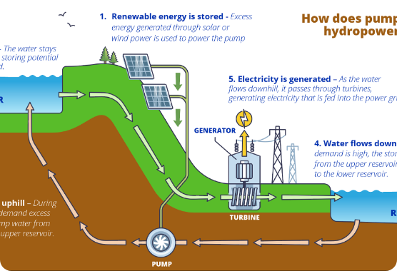
SYNTHETIC STORAGE PRODUCTS
Virtual Pumped Storage (VPS)
Synthetic Flexibility Contracting: Enables energy traders to simulate physical hydro/battery storage without asset ownership.
Spread Capture Arbitrage: Buyer stores power during low off-peak hours and dispatches during high peak demand hours.
Defined Efficiency Factors: Contractual round-trip efficiency (RTE) parameter compensates for storage energy losses.

Slide 9
VOLUMETRIC RISK MANAGEMENT
Weather Derivatives in Energy Markets
HDD / CDD
Wind Swaps
Solar Swaps
Degree Day Indices
Volumetric Wind Hedges
Irradiance Contracts
Heating & Cooling Degree Days measure temperature deviations from 18°C baseline.
Protects wind farm operators against low wind speed seasons (volume deficit).
Stabilizes revenues against prolonged cloud coverage and poor solar irradiance.
Volume Risk vs. Price Risk: Standard derivatives hedge commodity price fluctuations ($/MWh), whereas weather derivatives protect energy producers against volumetric output shortfall (MWh deficit) caused by anomalous atmospheric conditions.

Slide 10
CROSS-PRODUCT MATRIX
Structured Product Profile Comparison
Product | Underlying Asset | Primary Risk Hedged | Typical Horizon
EUA | EU Carbon Allowances | Emissions Compliance Cost | 1 to 5 Years
PPA / VPPA | Renewable Power Generation | Long-term Power Spot Volatility | 10 to 20 Years
VPP | Aggregated Asset Capacity | Intraday Imbalance & Frequency Risk | Real-Time to Annual
VPS | Hydro / Battery Storage Capacity | Peak / Off-Peak Price Spreads | Monthly to Multi-Year
Weather Derivative | Temperature / Wind / Solar Indices | Volumetric Production & Demand Shortfall | Seasonal (3 to 12 Months)

